Slide 1
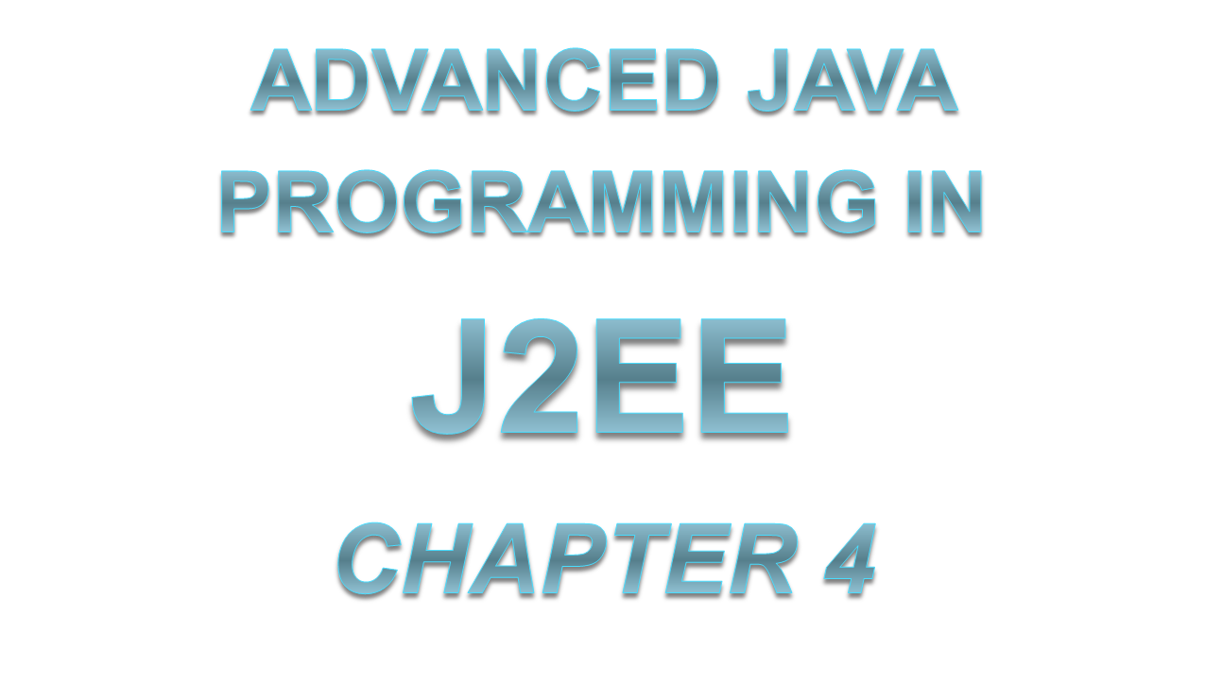
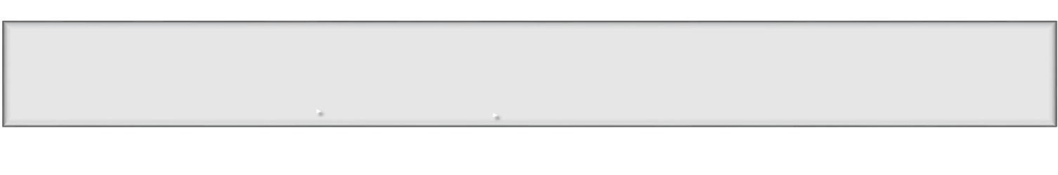

Slide 2

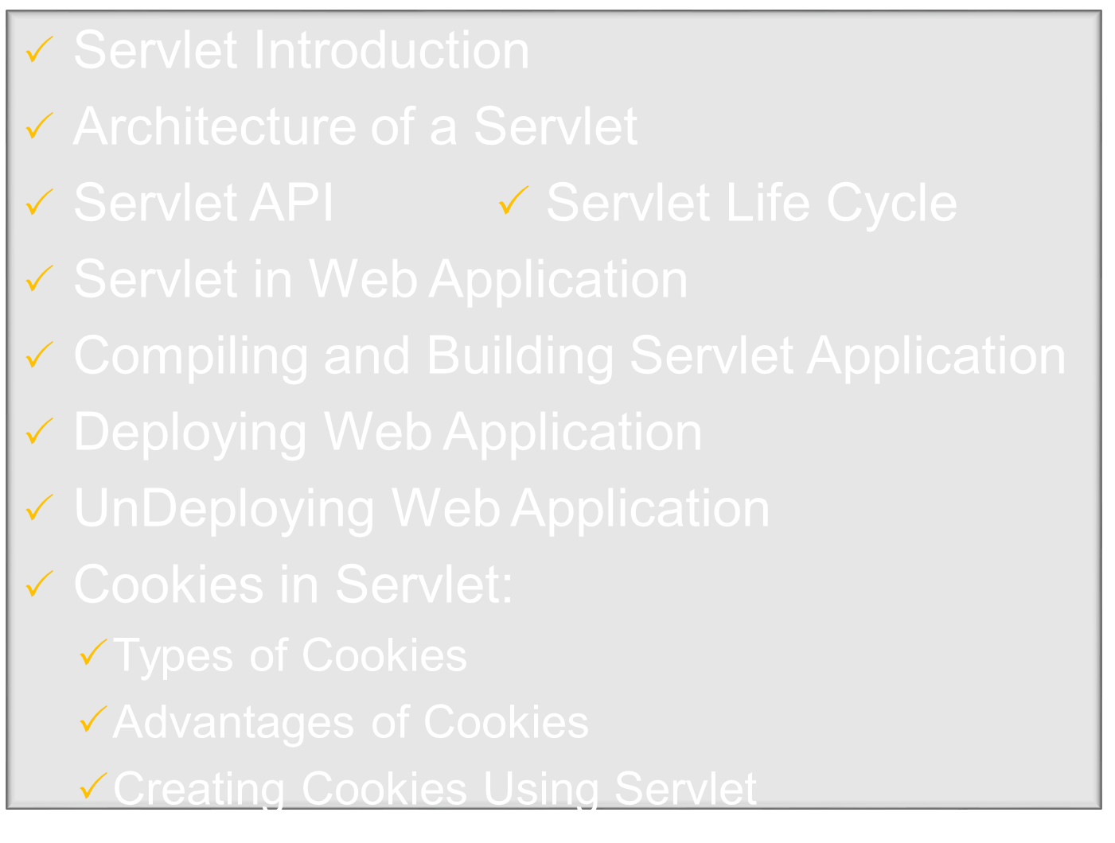
Notes:
Ch.1 Topics → from Sau Uni MCA-III Syllabus.

Slide 3

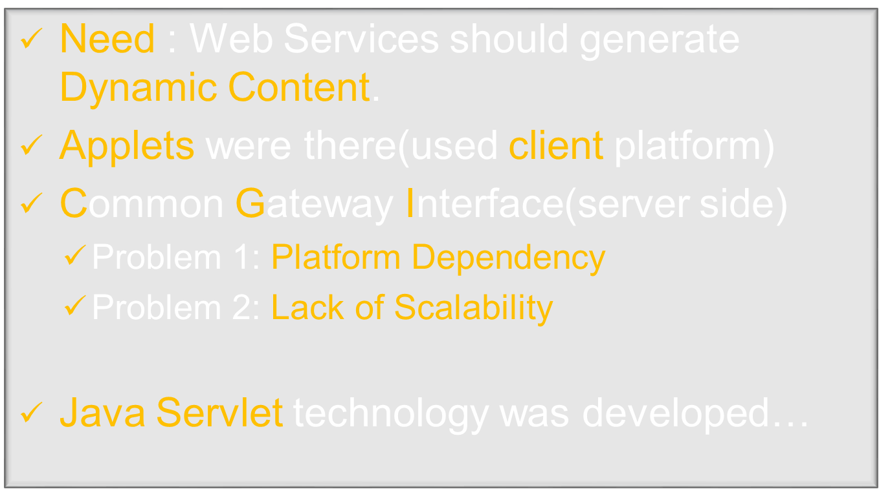
Notes:
Shortly after the Web began to be used for delivering services, service providers recognized the
need for dynamic content. Applets, one of the earliest attempts toward this goal, focused on
using the client platform to deliver dynamic user experiences. At the same time, developers also
investigated using the server platform for the same purpose. Initially, Common Gateway
Interface (CGI) server-side scripts were the main technology used to generate dynamic content.
Although widely used, CGI scripting technology had many shortcomings, including platform
dependence and lack of scalability. To address these limitations, Java Servlet technology was
created as a portable way to provide dynamic, user-oriented content.

Slide 4
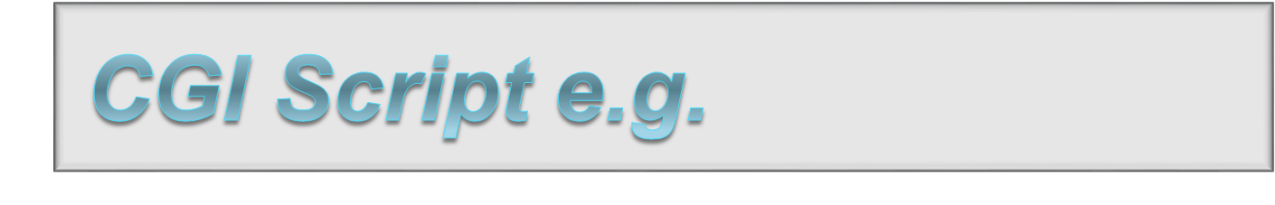
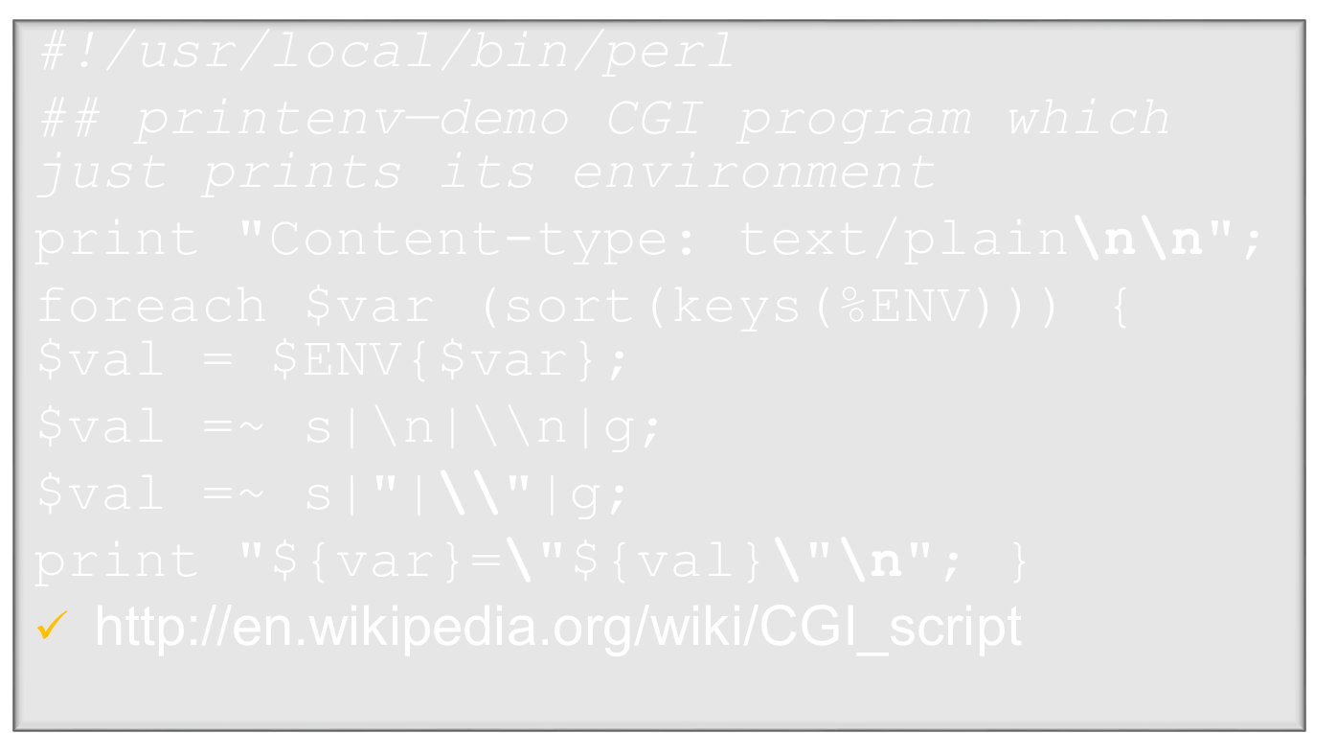
Notes:
The Common Gateway Interface (CGI) is a standard (see RFC 3875: CGI Version 1.1) that defines how web server software can delegate the generation of web pages to a stand-alone application or an executable file. Such applications, known as CGI scripts, can be written in any programming language, although scripting languages are often used.

Slide 5

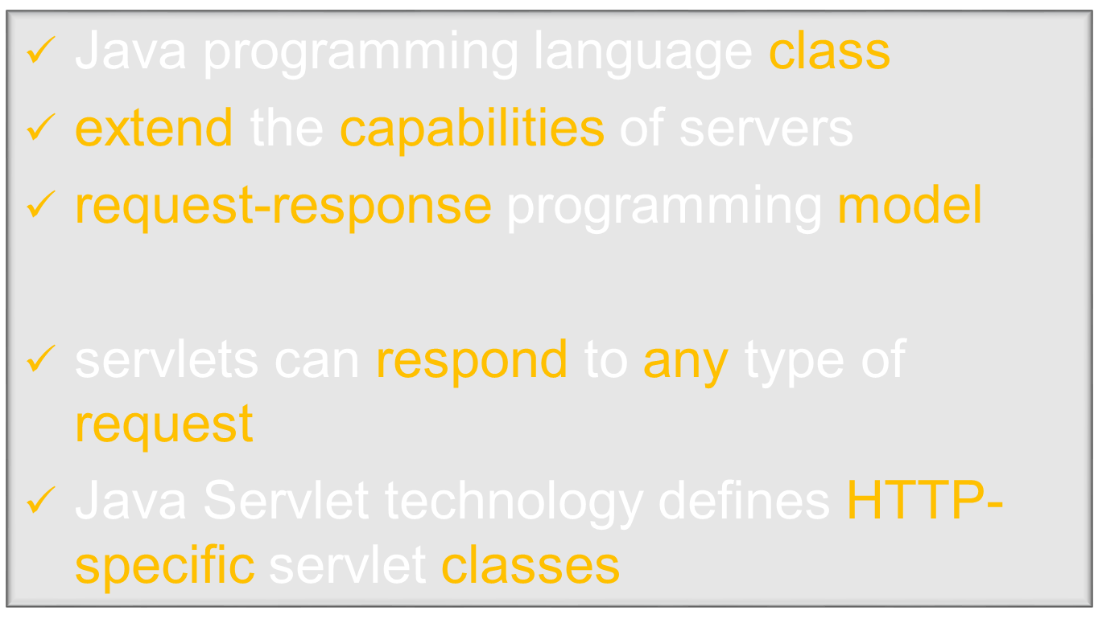
Notes:
A servlet is a Java programming language class used to extend the capabilities of servers that
host applications accessed by means of a request-response programming model. Although
servlets can respond to any type of request, they are commonly used to extend the applications
hosted by web servers. For such applications, Java Servlet technology defines HTTP-specific
servlet classes.

Slide 6
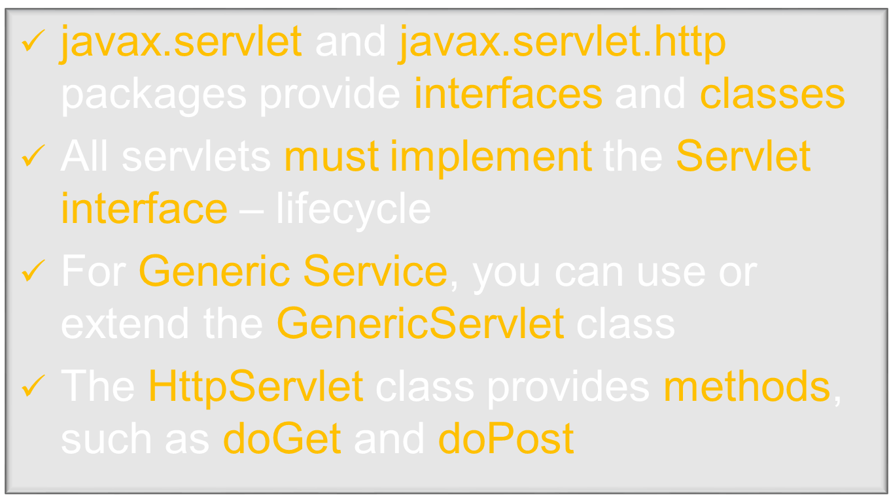
Notes:
The javax.servlet and javax.servlet.http packages provide interfaces and classes for
writing servlets. All servlets must implement the Servlet interface, which defines lifecycle
methods. When implementing a generic service, you can use or extend the GenericServlet
class provided with the Java Servlet API. The HttpServlet class provides methods, such as
doGet and doPost, for handling HTTP-specific services.

Slide 7




Generic Servlet
HTTP Servlet
My Servlet
http://www.cse.iitb.ac.in/dbms/Data/Courses/DBIS/Software/servlets/servlet_tutorial.html
http://r4r.co.in/java/servlet/topics/basics/servlets/Servlet_architecture.shtml
Notes:
A servlet is an object that extends either the javax.servlet.GenericServlet class or the javax.servlet.http.HttpServlet class. The javax.servlet.GenericServlet class defines methods for building generic, protocol-independent servlets. The javax.servlet.http.HttpServlet class extends this class to provide HTTP-specific methods.

Slide 8

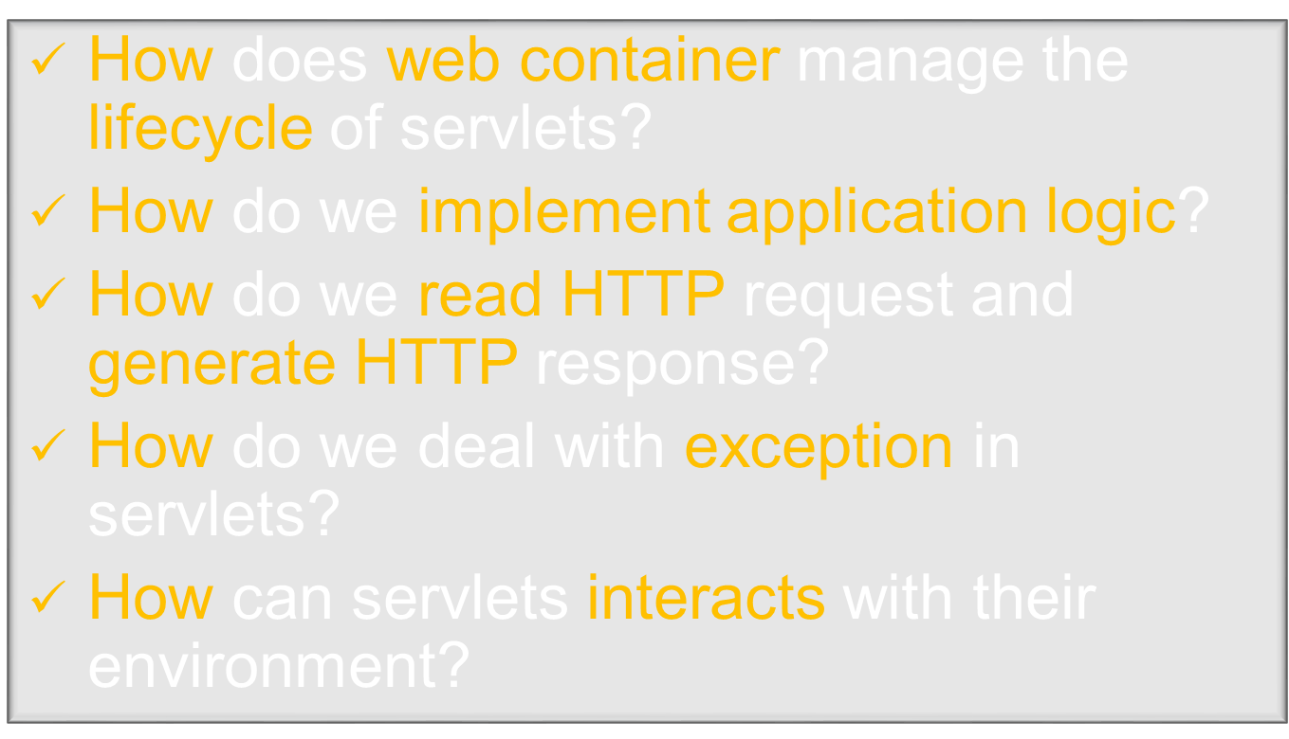
Notes:
261

Slide 9
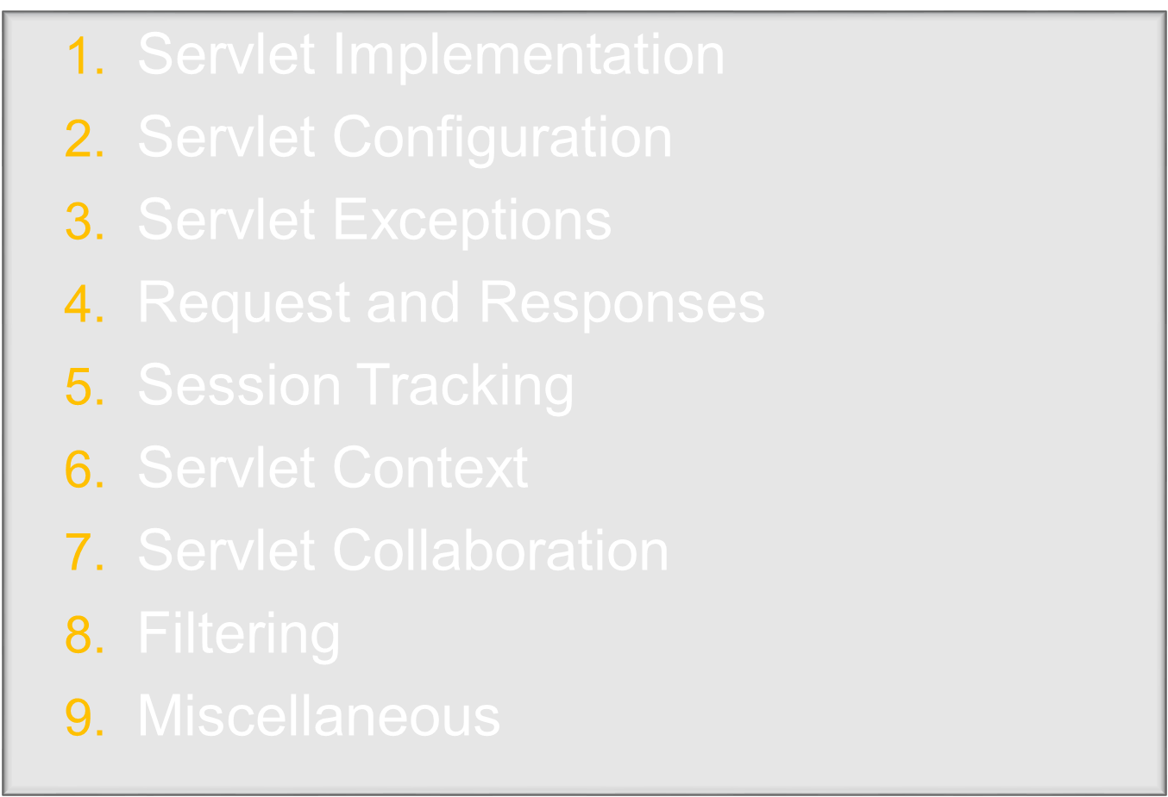

Slide 10

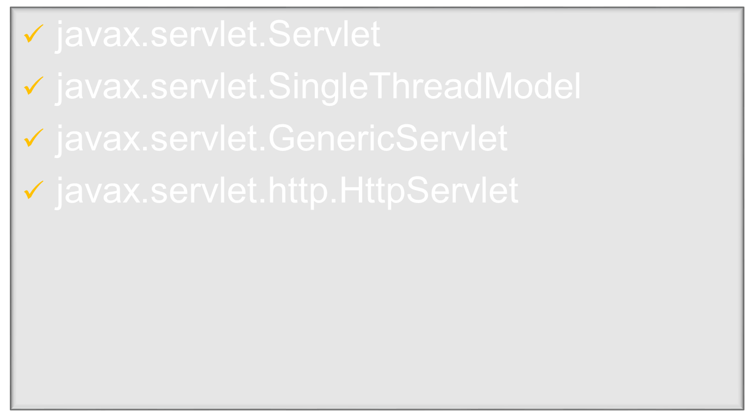
Notes:
The classes/interfaces in this category are meant for implementing servlets. For instance, the GreetingServlet class in the previous chapter extends the HttpServlet class. To develop our own servlets, we would implement one or more methods in these classes/interfaces. When we deploy servlets, the web container invokes these methods to control their lifecycle, and to execute application logic.

Slide 11

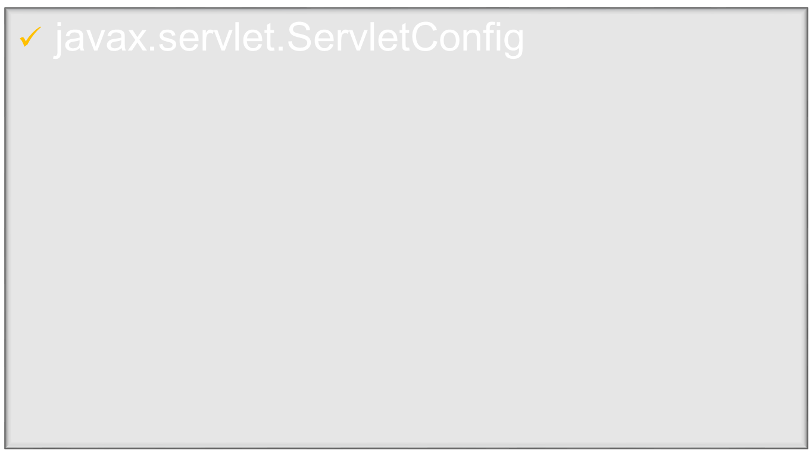
Notes:
The ServletConfig interface belongs to this category. The Servlet API provides various means of accessing the ServletConfig object associated with a servlet. This object provides access to certain initialization parameters that can be configured while deploying a servlet.

Slide 12

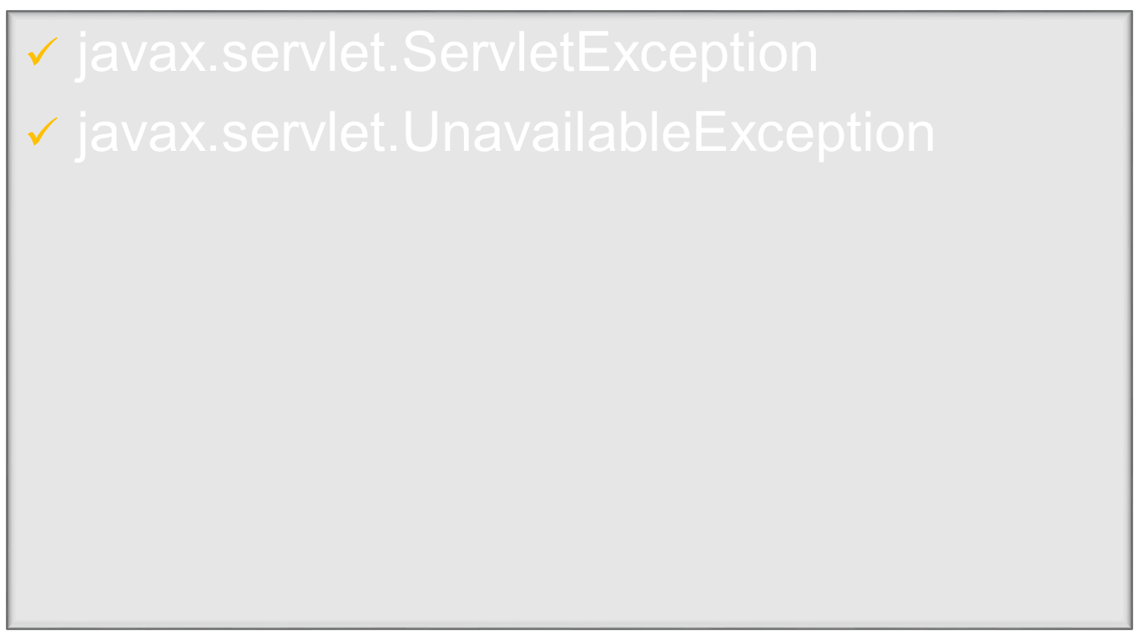
Notes:
The Java Servlet API specifies two exceptions : ServletException and UnavailableEception. Typically, servlets throw these exceptions, which the container then catches to perform appropriate error handling.

Slide 13

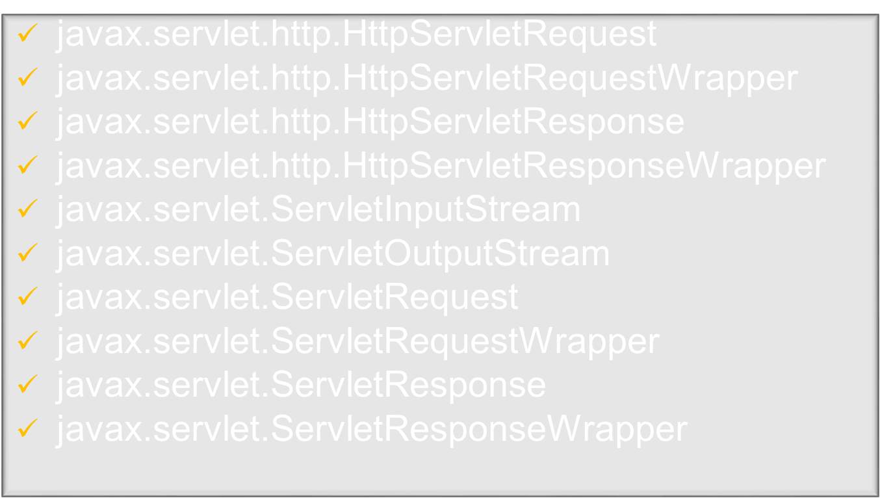
Notes:
There are fouur interfaces and two abstract classes in this category. These objects provide method to access, and the underlying input and output streams associated with the, client connection. Using these objects, we can read data from the input, and write data back to the client.
In addition to the above, the servlet 2.3 specification introduced wrapper classes for ServletRequest, ServletResponse, http.HttpServletRequest and http.HttpServletResponse classes. Although all these classes are not abstract, they do not actually contain any functionality.

Slide 14

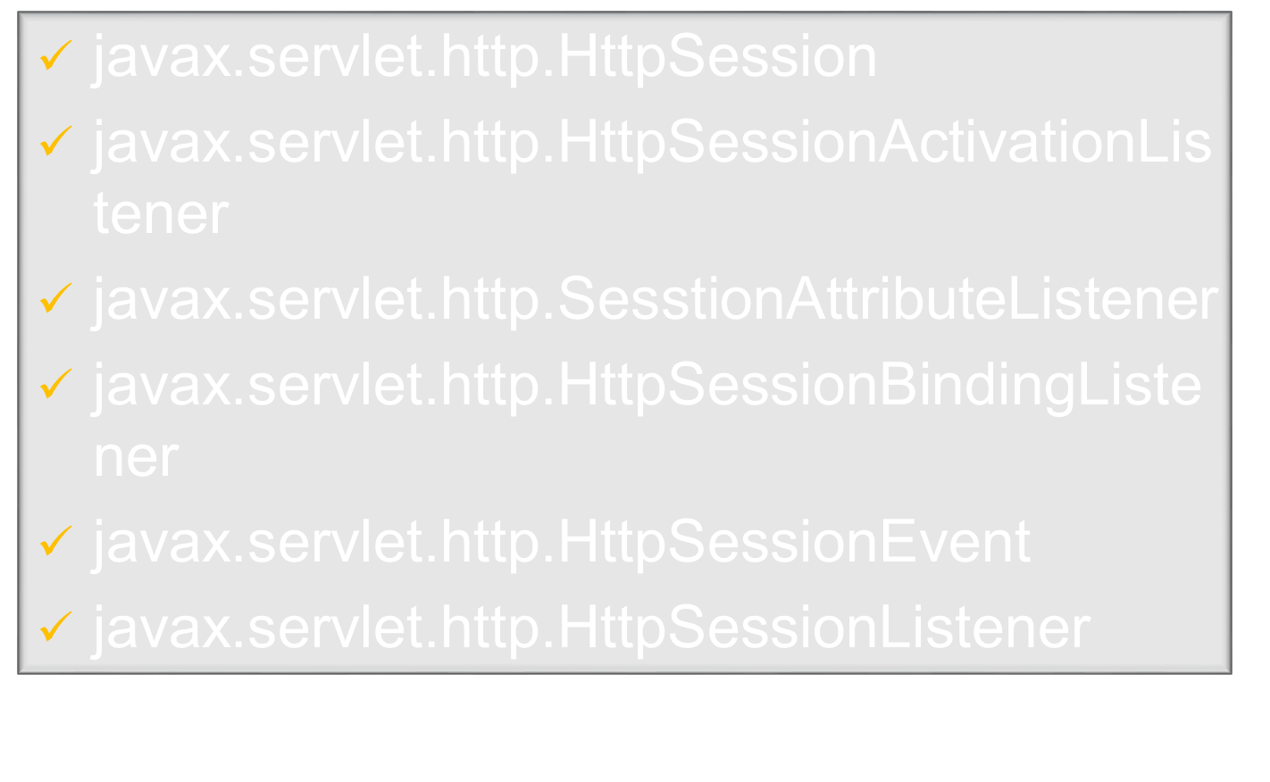
Notes:
Session tracking is one of the crucial part of web application development. Http, which is the basic protocol for web applications, is stateless. As a result, web applications cannot recognize multiple requests from the same HTTP client as originating from the same place. The notion of a session provides this abstraction. In simple term, a session lets you group requests into a collected group. In addition, session management also involves associating data with each session. The Servlet API specifies the javax.servlet.HttpSession interface to provide this abstraction.

Slide 15

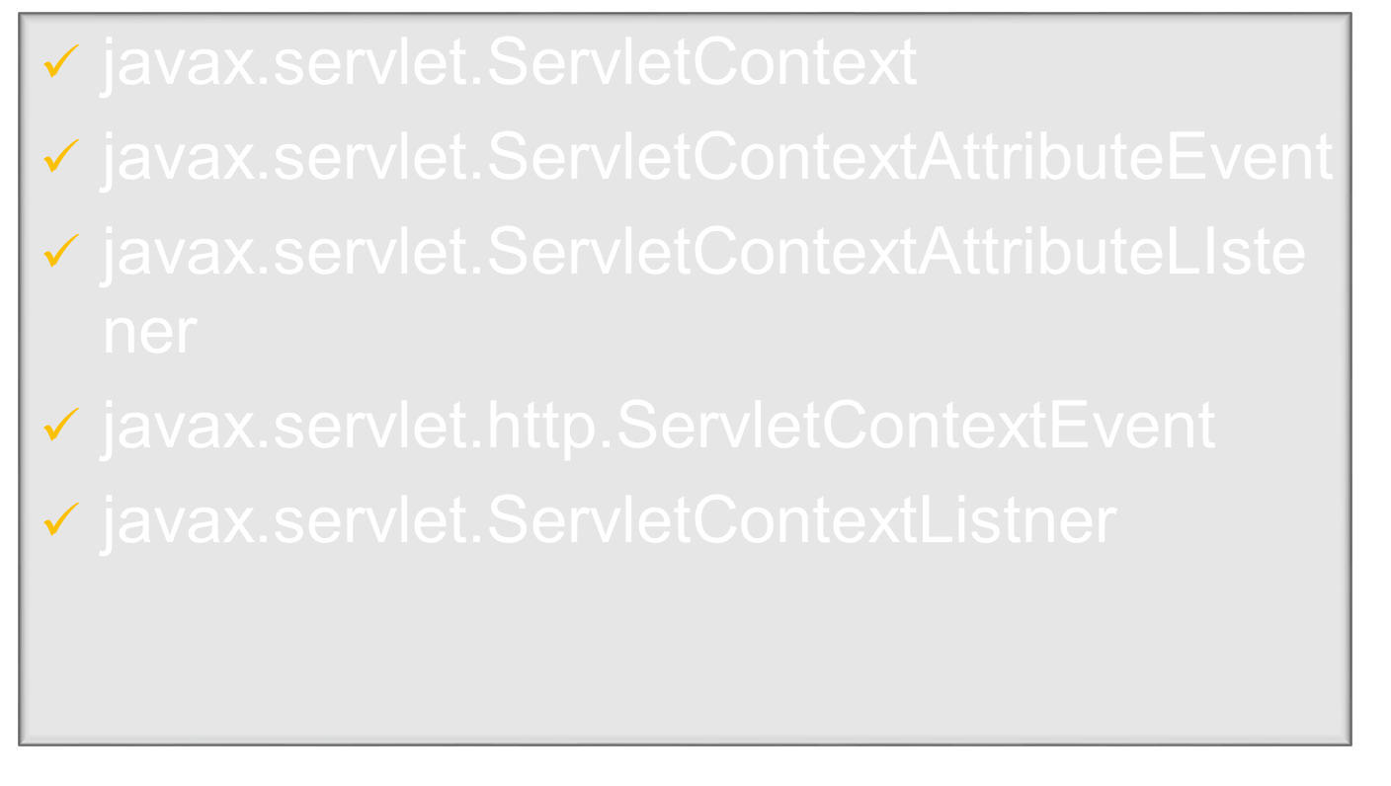
Notes:
The notion of servlet context is closely associated with the notion of a web application. The interface javax.servlet.ServletContext allows servlets in an application to share data. It also provide methods with which servlets can access the host web container. Using the ServletContext objects servlet can log events, obtain URL references to resources, and set and store attributes that other servlets in the context can access.

Slide 16

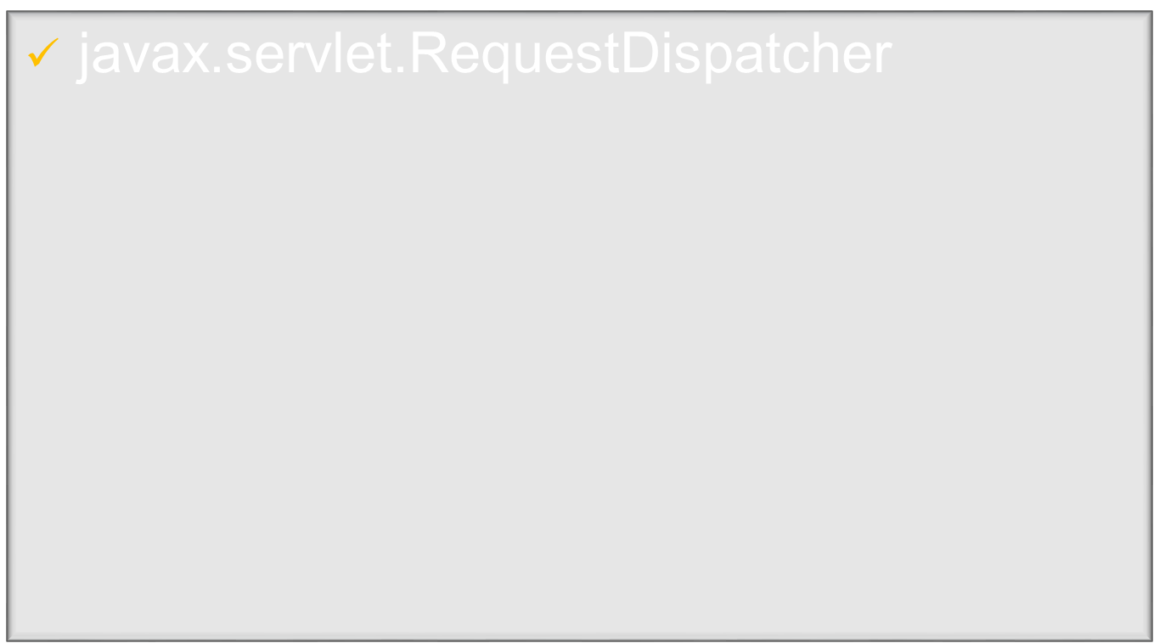
Notes:
The Servlet API also provides an interface (RequestDispatcher) with which a servlet can invoke another servlet, a JSP, or even a static resource such as an HTML page. This mechanism helps you to control the flow of logic across multiple servlets and JSP pages programmatically.

Slide 17

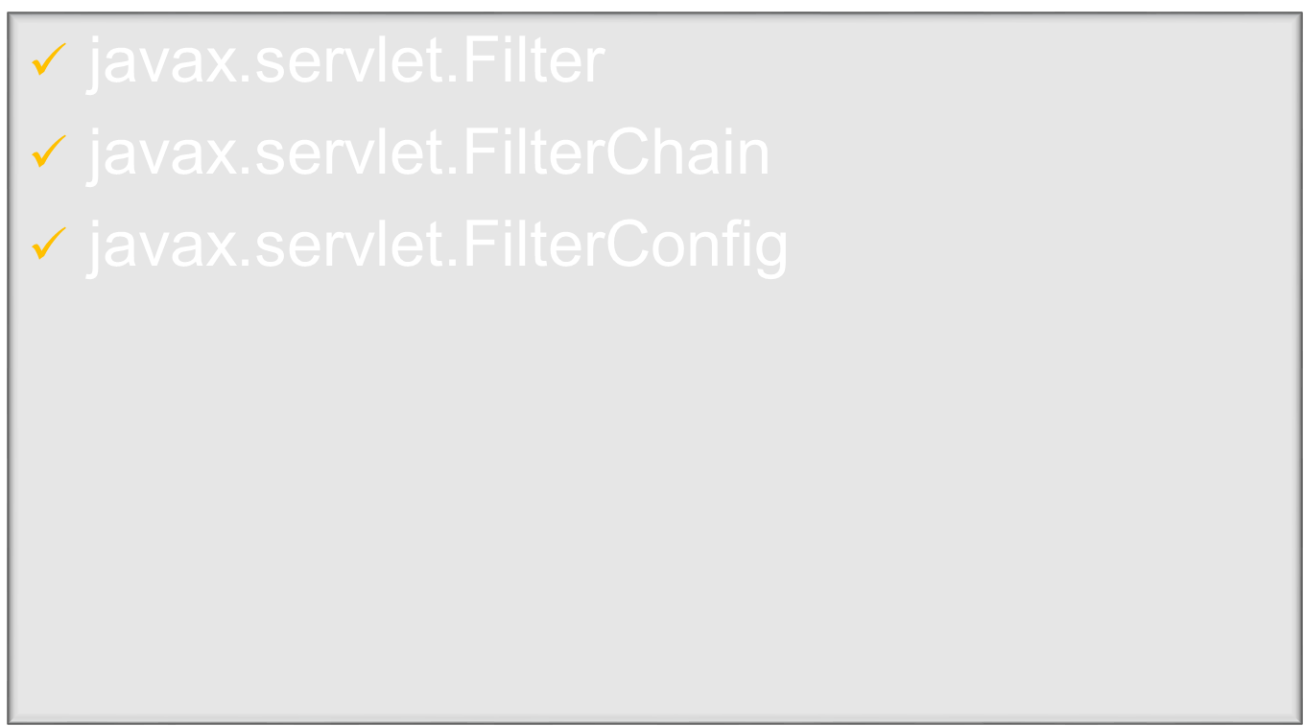
Notes:
The Servlet API has a mechanism with which we can introduce code (called a filter) to participate in the container’s request/response process. Filters are a new feature of the Java Servlet API version 2.3. They do not generally create Requests/responses; rather, they modify or adapt request and responses to and from a web resource, which could have static or dynamic content.

Slide 18

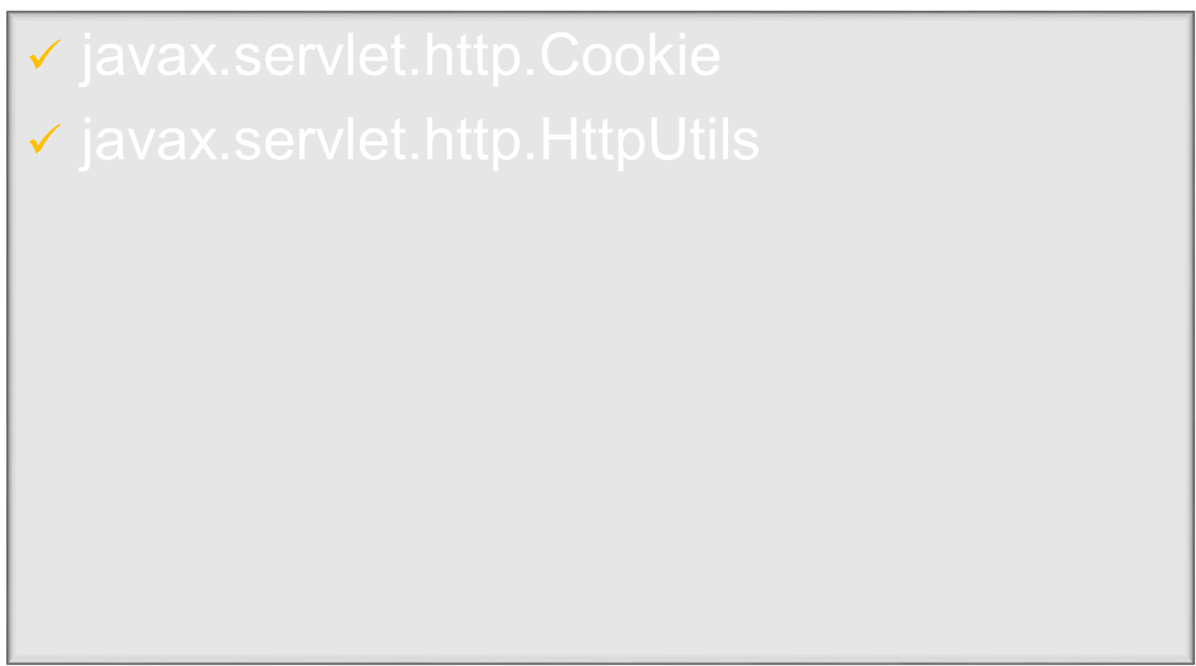
Notes:
Under this category, you’ll find two classes: http.Cookie, which you can use to create cokkies, and http.HttpUtils, which provide miscellaneous help methods.

Slide 19
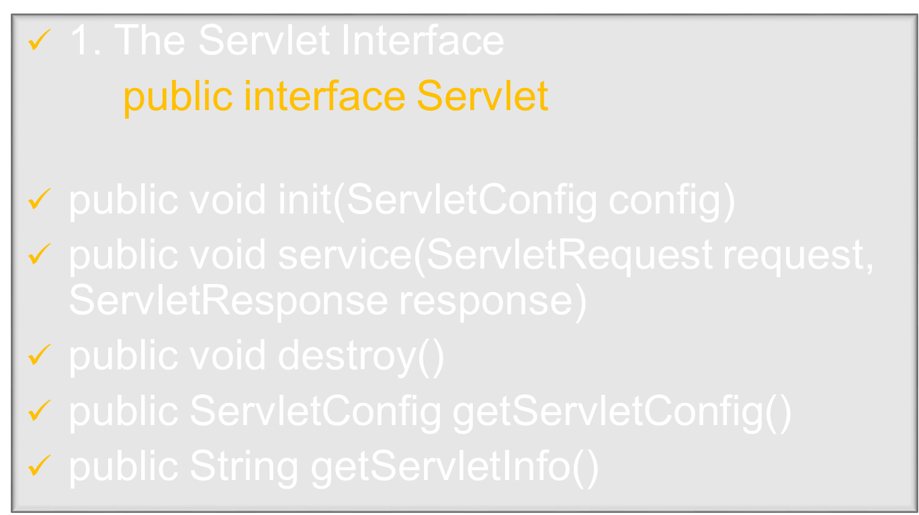

Slide 20

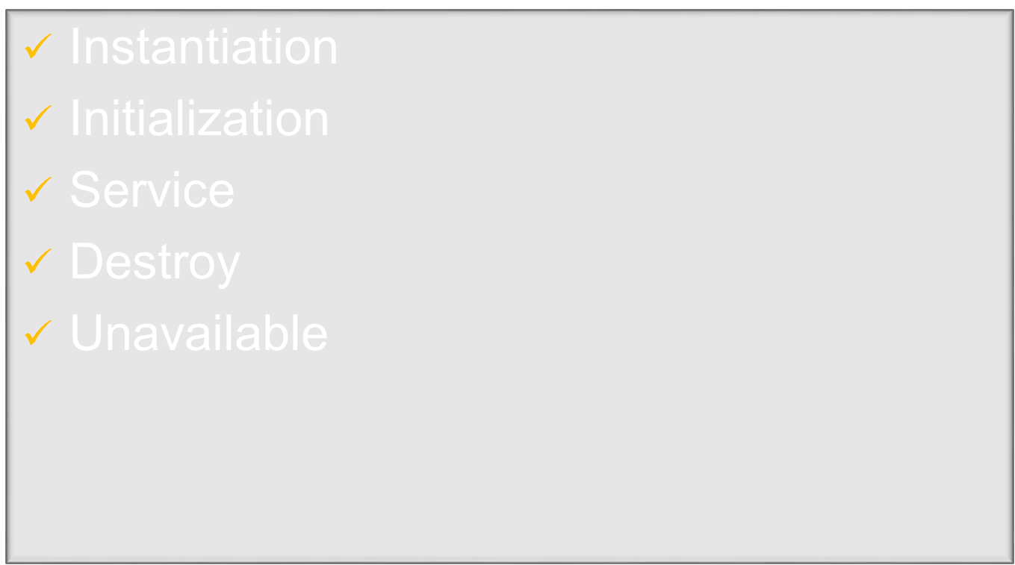

Slide 21

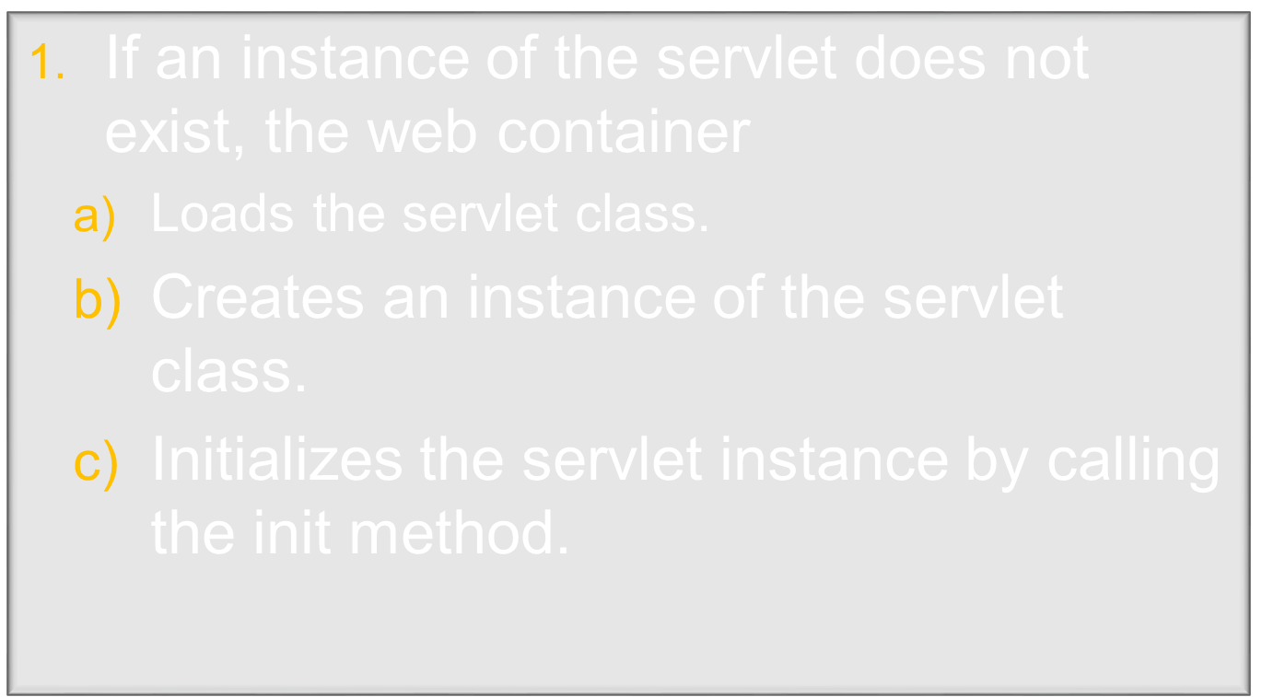
Notes:
The lifecycle of a servlet is controlled by the container in which the servlet has been deployed.
When a request is mapped to a servlet, the container performs the following steps.
1. If an instance of the servlet does not exist, the web container
a. Loads the servlet class.
b. Creates an instance of the servlet class.
c. Initializes the servlet instance by calling the init method. Initialization is covered in
“Creating and Initializing a Servlet” on page 333.

Slide 22
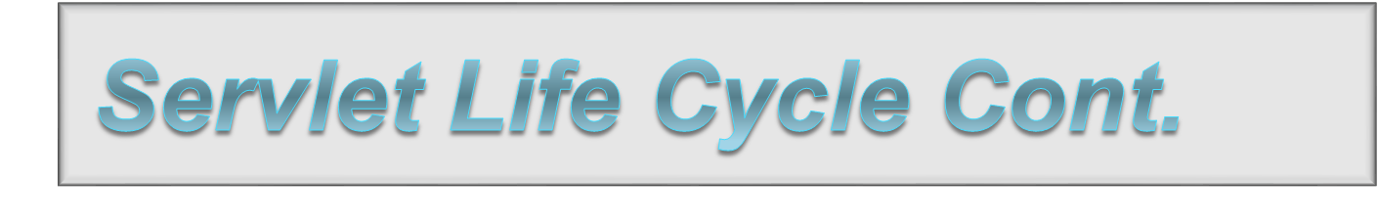
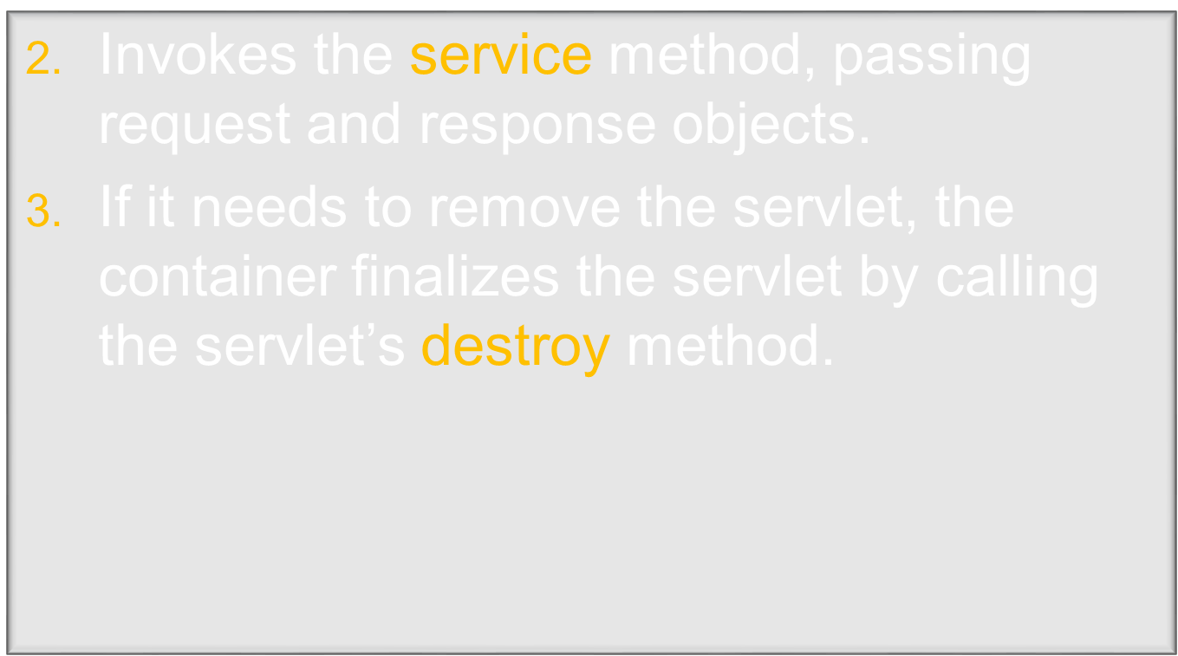
Notes:
2. Invokes the service method, passing request and response objects. Service methods are
discussed in “Writing ServiceMethods” on page 334.
If it needs to remove the servlet, the container finalizes the servlet by calling the servlet’s
destroy method. For more information, see “Finalizing a Servlet” on page 344.

Slide 23

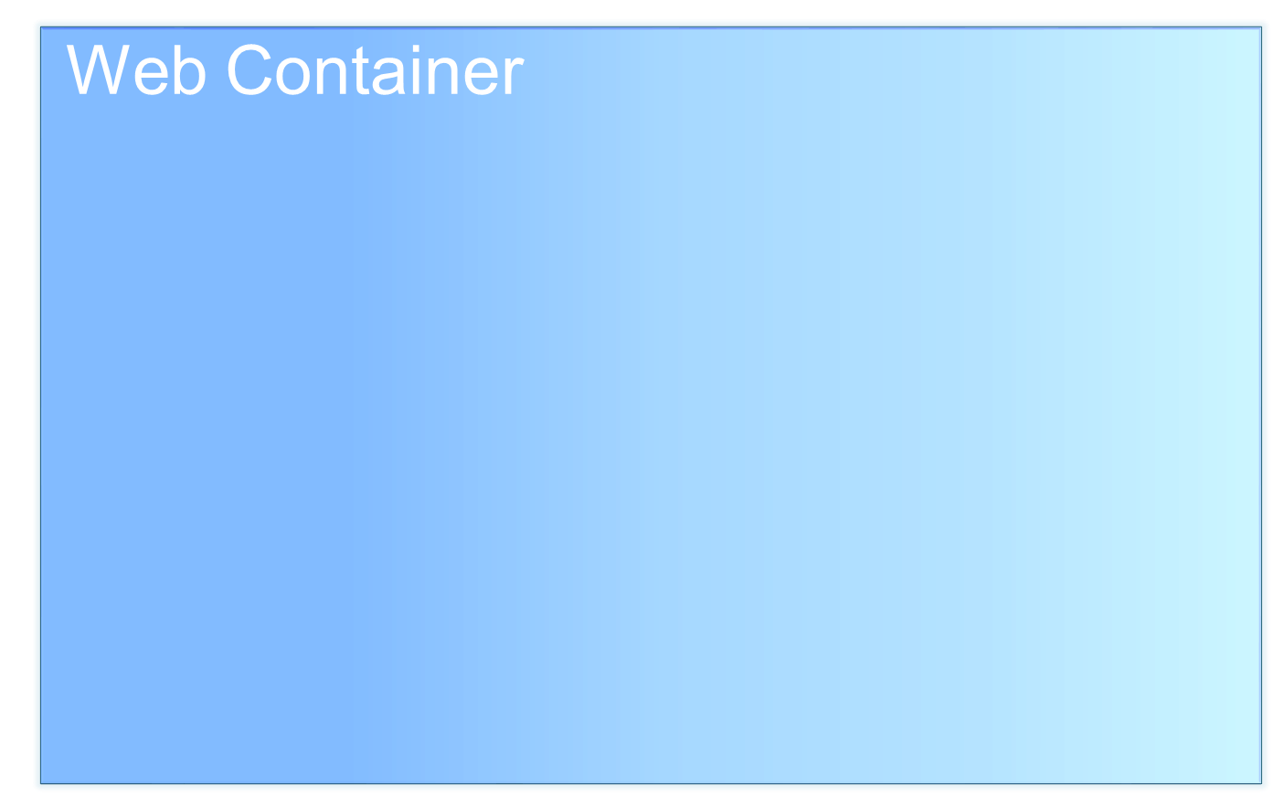

Slide 24


Slide 25
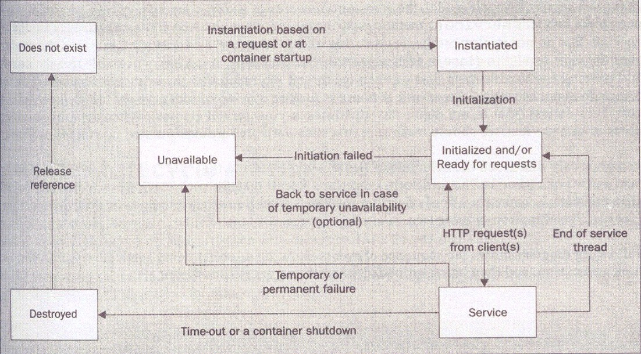

Slide 26


Slide 27
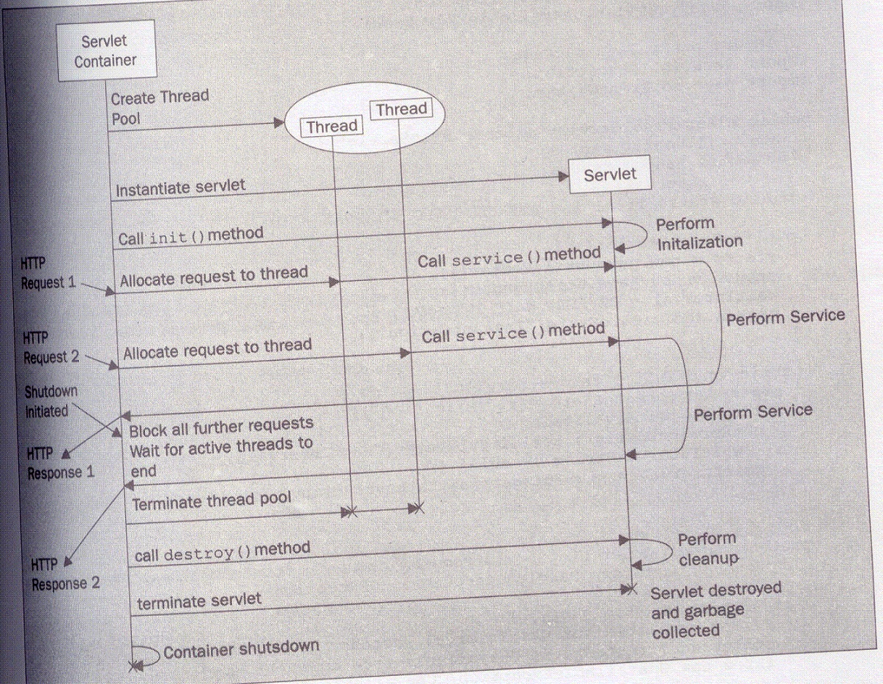

Slide 28
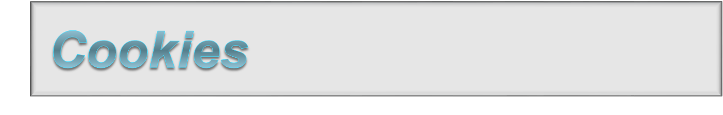
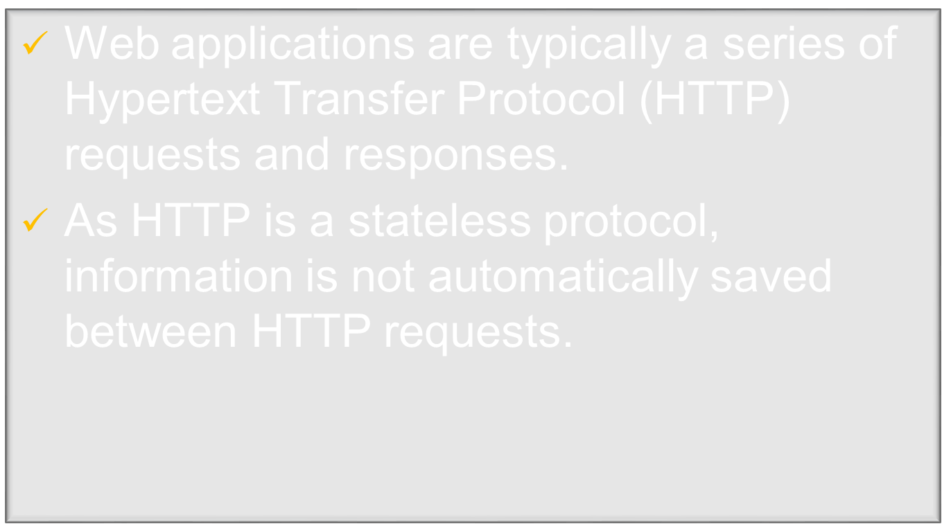
Notes:
Introduction
Cookies are a way of storing data on the client side. They have been used extensively for personalization of portal sites, user preference tracking, and logging into web sites. For enterprise customers using cookies in their web sites, cookie support in Java Plug-in and Java Web Start facilitates deployment of client-side Java.
Cookie support allows a Java application to pass a cookie back to a web server if that cookie originated from the web server. This provides the server with information about the state of the client.

Slide 29
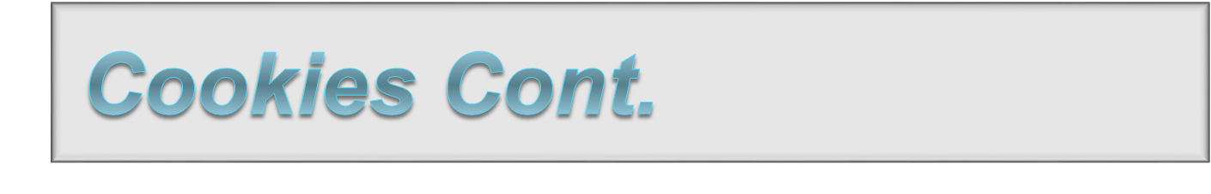
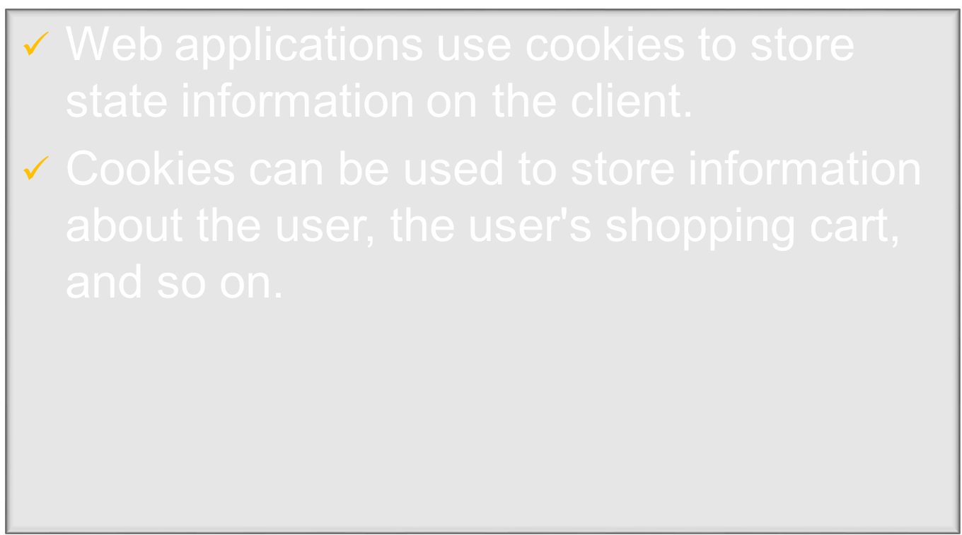

Slide 30

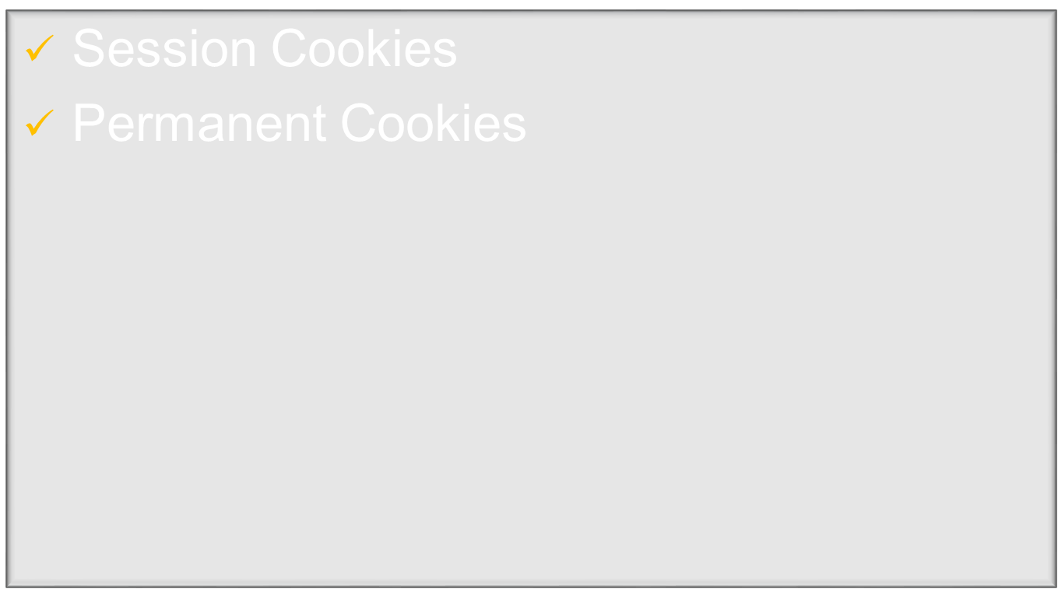

Slide 31

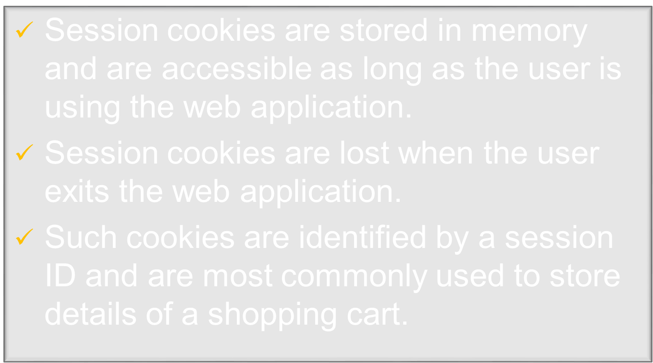
Notes:
Session Cookies
Session cookies are stored in memory during the applet or application session. Session cookies expire when the applet or application exits and are automatically deleted. These cookies usually store a session ID that is not personally identifiable to users, allowing the user to move from page to page without having to log-in repeatedly. They are widely used by commercial web sites (for example, to keep track of items that a consumer has added to a shopping cart.)

Slide 32

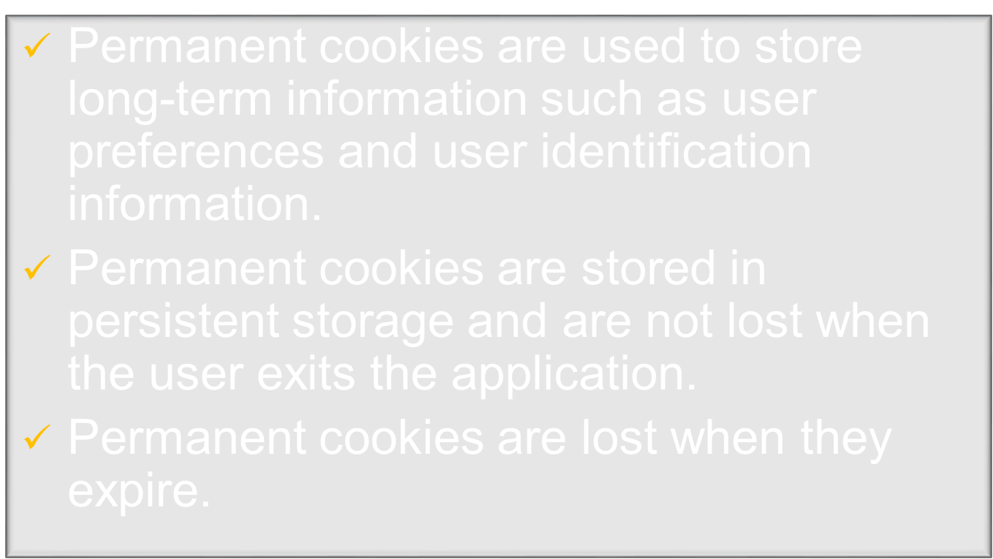
Notes:
Permanent Cookies
Permanent cookies are stored in persistent storage and are not deleted when the application exits. They are deleted when they expire. They can retain user preferences for a particular web site, allowing those preferences to be used in future sessions. Permanent cookies can be used to identify individual users, so they may be used by web sites to analyze users' surfing behavior within the web site. These cookies can also be used to provide information about the numbers of visitors, the average time spent on a particular page, and the general performance of the web site. They are usually configured to keep track of users for a prolonged period of time, in some cases many years into the future.

Slide 33

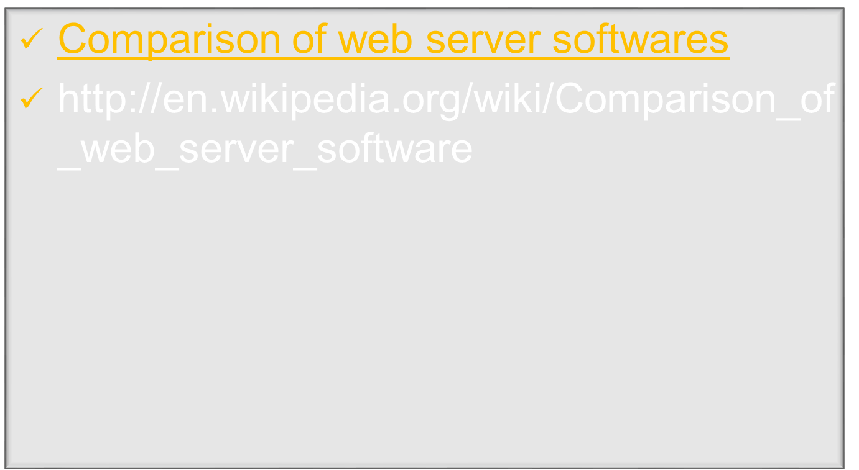

Slide 34

The Java EE 6 Tutorial – April 2012
– Oracle
Java Server Programming Black Book
  – Dreamtech Publications

